Slide 1
CUSTOMER PURCHASE BEHAVIOR ANALYSIS
BY:
Gauri Arora, Shraddha Khedkar, Ayan Sarkar
Notes:
Shraddha

Slide 2
AGENDA
Objectives
Data
Modeling methods used
Conclusion
Q&A
Notes:
Shraddha

Slide 3
OBJECTIVES
Analyze purchasing patterns of the customers of a retail company
Understand the customer purchase behavior
Notes:
Shraddha

Slide 4
About Data
Variable | Definition
User_ID | User ID
Product_ID | Product ID
Gender | Sex of User
Age | Age in bins
Occupation | Occupation (Masked)
City_Category | Category of the City (A,B,C)
Stay_In_Current_City_Years | Number of years stay in current city
Marital_Status | Marital Status
Product_Category_1 | Product Category (Masked)
Product_Category_2 | Product may belong to another category also (Masked)
Product_Category_3 | Product may belong to another category also (Masked)
Purchase | Purchase Amount (Target Variable)
550068 records and 12 variables
11 nominal variables
Missing values in only 2 variables
Information about Demographics, product details and total purchase amount
Notes:
Missing Values were encountered in only 2 variables: Product Category 2 (30 % missing values) and Product Category 3 (70% missing values)
Product 3 category field had 70% missing values; so, we dropped it from our analysis
7 age levels
But we converted all the categorical variables into three levels namely: High, Medium and Low so that the target marketing is more effective

Slide 5
About Variables
Purchase was Target Variables
All others were independent variables except Product Category_3

Slide 6
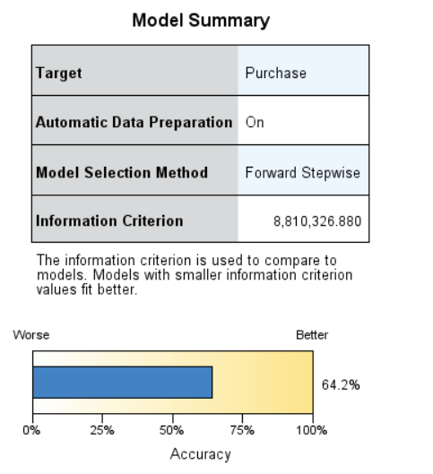
MODELING
LINEAR REGRESSION
R² = 0.642
Model Selection Method: Forward Stepwise
Notes:
Adjusted R²: 64.2%
Model Selection method: Forward Stepwise
Predictors: Stay in Current City, Gender, City Category, Age, Occupation, Product_Category_1, Product_Category_2
Target: Purchase
The scatter plot for the Predicted Vs. Actual values indicate that the predictions have been moderately well.
The residuals tend to follow a normal distribution.
The residuals tend to be very close by the perfect regression line
The most important predictor was Product_Category_1

Slide 7
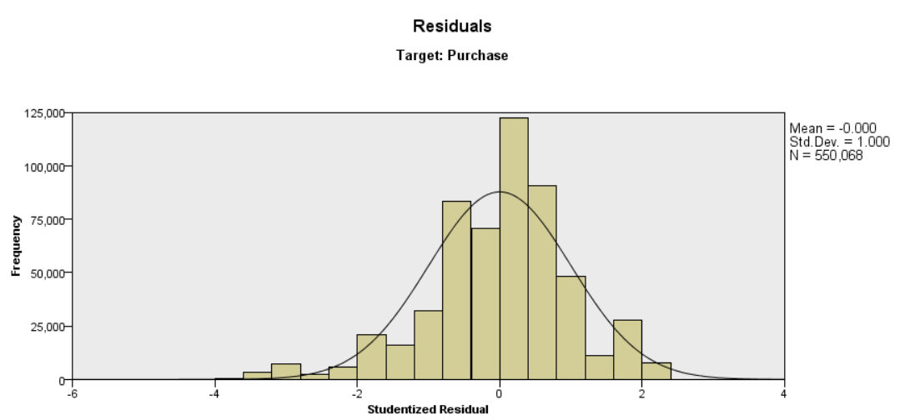
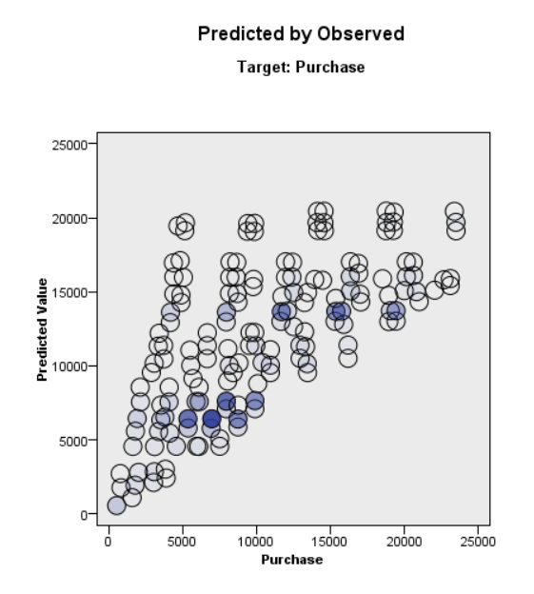
Linear Regression
Normal Distribution of residuals
Binned Scatterplot
Notes:
The graph is normally distributed. Therefore, we can say that the residuals are normally distributed
Binned Scatterplot: This displays a binned scatterplot of the predicted values on the vertical axis by the observed values on the horizontal axis. Ideally, the points should lie on a 45-degree line; this view can tell you whether any records are predicted particularly badly by the model.

Slide 8
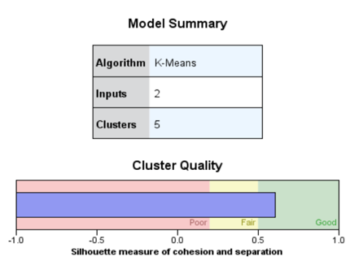
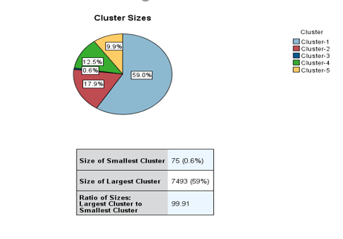
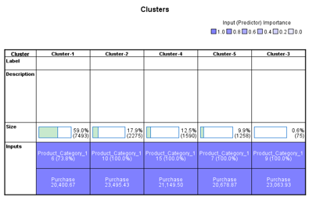
K-Means for Product_Category Group1
Notes:
This model was built for the price range > 20000.
Model for Product Category Group 1
Inputs: Purchase, Product_Category_1
K=5
Cluster Quality: 0.6
Product Category 10 has highest mean Purchase Price of $23495.43

Slide 9
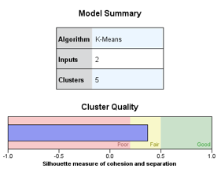
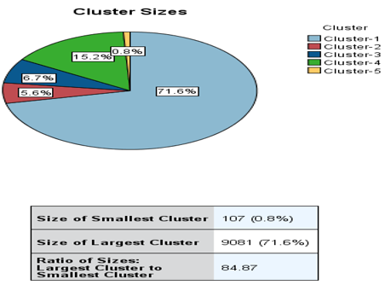

K-Means for Product_Category Group2
Notes:
Model for Product Category Group 2
Inputs: Purchase, Product_Category_2
K=5
Cluster Quality: 0.4
Product Category 14 has highest mean Purchase Price of $23524.11

Slide 10
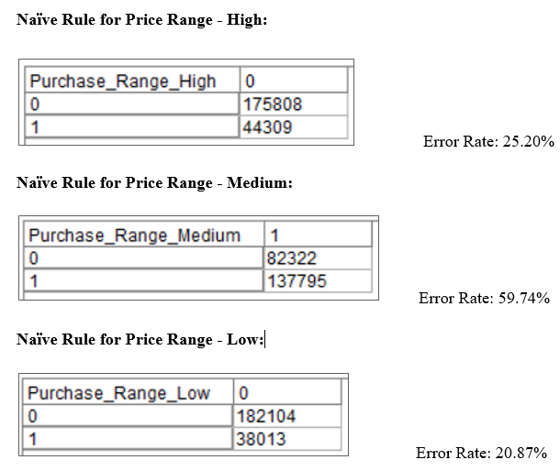
NAÏVE RULE
Naïve Rule was used to calculate Error rates for Predicting price ranges of “High”, “Medium” & “Low” in the Testing Data set.
Error Rate for “High” price range: 25.20%
Error Rate for “Medium” price range: 59.74%
Error Rate for “Low” price range: 20.87%

Slide 11
APRIORI
High: If a sales transaction contains product categories: 2 to 7 from Product Category Group 2 and the customer is a male, then it is 1.74 times more likely than a general guess, that this is a transaction of a high range of purchase price

Slide 12
APRIORI
Medium: If a sales transaction contains product categories: 8 to 14 from Product Category Group 1& product categories: 8 to 12 from Product Category Group 2, then it is 1.243 times more likely than a general guess, that this is a transaction of a medium range of purchase price

Slide 13
APRIORI
Low: If a sales transaction contains product categories: 8 to 14 from Product Category Group 1& product categories: 13 to 18 from Product Category Group 2, then it is 1.562 times more likely than a general guess, that this is a transaction of a low range of purchase price

Slide 14
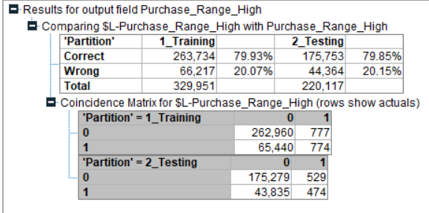
LOGISTIC REGRESSION
Logistic Regression for HIGH
Error Rate in Testing Data Set: 20.15%, lesser than Naïve Rule error rate of 25.20%; thus, proving to be an effective model

Slide 15
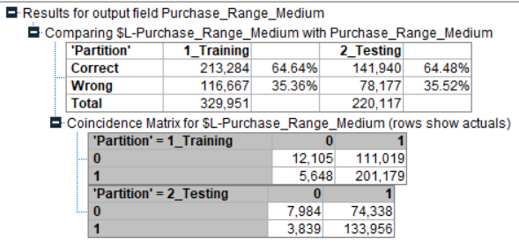
LOGISTIC REGRESSION
Logistic Regression for MEDIUM
Error Rate in Testing Data Set: 35.52%, lesser than Naïve Rule error rate of 59.74%; thus, proving to be an effective model

Slide 16
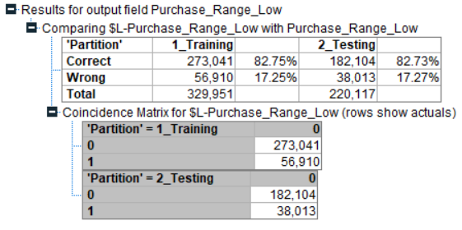
LOGISTIC REGRESSION
Logistic Regression for LOW
Error Rate in Testing Data Set: 17.27%, lesser than Naïve Rule error rate of 20.87%; thus, proving to be an effective model

Slide 17
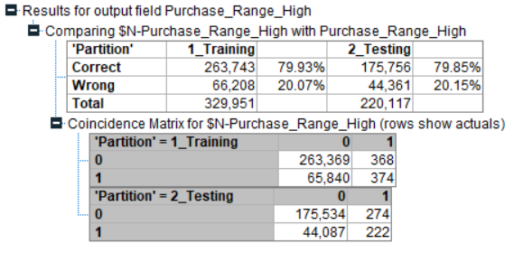
NEURAL NETS
Neural Nets for Price Range High
Notes:
Model for Purchase Ranges: “High”: Error Rate in Testing Data Set: 20.15%, lesser than Naïve Rule error rate of 25.20%; thus, proving to be an effective model

Slide 18
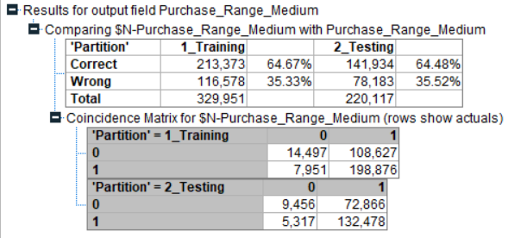
NEURAL NETS
Neural Nets for Price Range Medium
Notes:
Model for Purchase Ranges: “Medium”: Error Rate in Testing Data Set: 35.52%, lesser than Naïve Rule error rate of 59.74%; thus, proving to be an effective model

Slide 19
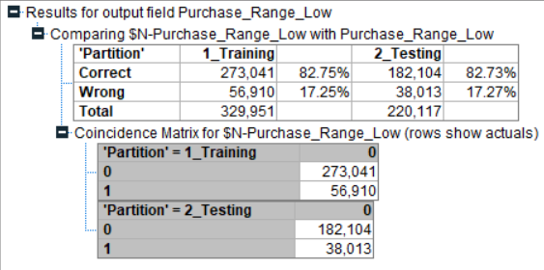
NEURAL NETS
Neural Nets for Price Range Low
Notes:
Model for Purchase Ranges: “Low”: Error Rate in Testing Data Set: 17.27%, lesser than Naïve Rule error rate of 20.87%; thus, proving to be an effective model

Slide 20
CONCLUSION
Hindered predictive power of linear regression model
Male customers exhibit a trend of shopping in the high and medium purchase price range
Logistic Regression & the Neural Nets gives us the same predictive power in terms of the Error /Accuracy.
No significant trend by Apriori Algorithm in the customer demographic
Notes:
Predicting a continuous target variable with only categorical variables as the predictors, seems to hinder the predictive power of a linear regression model. In our case, the model could only explain 62% of the variability in the data

Slide 21
Thank you!
Questions?

